Slide 1
Disjoint Set
Session 33-34
Henry Lucky, S.Kom, M.Kom.

Slide 2
Learning Outcome
At the end of this session, students will be able to:
LO 1: Explain the concept of data structures and its usage in Computer Science
LO 2: Illustrate any learned data structure and its usage in application
LO 3: Apply data structures using C

Slide 3
Subtopics
Set
Disjoint-set
Disjoint set operations
Disjoint set forest
Union by rank
Path Compression

Slide 4
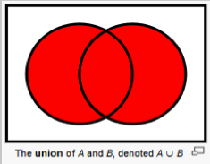
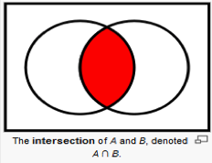
Set
concept
A set is a collection of distinct objects.
A = {1, 2, 3}
B = {3, 4, 5}
Basic Operations:
Union: Two sets can be added.
A ∪ B = {1, 2, 3} ∪ {3, 4, 5} = {1, 2, 3, 4, 5}
Intersection: Common members of both sets.
A ∩ B = {1, 2, 3} ∩ {3, 4, 5} = {3}

Slide 5
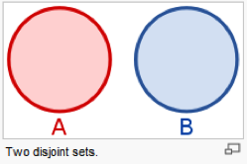
Disjoint Sets
Concept
Disjoint sets: Two sets, A and B, are disjoint if they have no element in common.
A = {1, 2, 3}
B = {7, 8, 9}
Some applications involve grouping n distinct elements into a collection of disjoint sets.
These applications often need to perform two operations in particular: finding the unique set that contains a given element and uniting two sets.

Slide 6

Disjoint Sets
Applications
Disjoint set can be used to know whether if you are connected in any way to another person in social media.

Slide 7
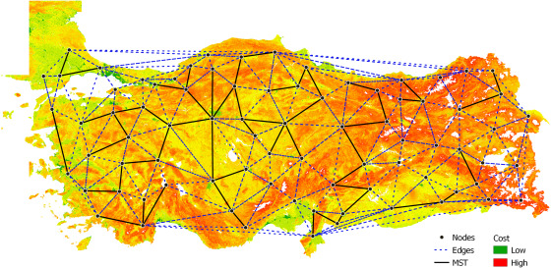
Disjoint Sets
Applications
Disjoint set can also be used to find the shortest way to connect all the city in an island (MST).

Slide 8
Disjoint sets
Data Structures Concept
A disjoint set data structure maintains a collection of disjoint dynamic sets.
S = {S1, S2, …, Sk}
S1 = {1, 2, 3}
S2 = {5, 6}
…
Sk = {88, 89}

Slide 9
Disjoint sets
Data Structures Concept
Each set is identified by a representative, a member of the set.
Doesn’t matter which member is used as the representative.
If we request the representative member twice without modifying the set between requests, we should get the same member.
We can specify a rule, or we can use the smallest member as the representative.
S1 = {1, 2, 3} Representative of S1 may be 1.
S2 = {5, 6} Representative of S2 may be 5.

Slide 10
Disjoint sets Operations
Operations: Make-set
Operations of disjoint-set data structure:
MAKE-SET(x): creates a new set whose only member is x. Make a new set Si = {x}, and add Si to S.
Initial member: 1, 2, 4, 5
S₁ = {1}, S₂ = {2}, S₄ = {4}, S₅ = {5}
S = {S₁ ,S₂, S₄, S₅}

Slide 11
Disjoint sets Operations
Operations: Union
Operations of disjoint-set data structure:
UNION(x, y): unites the dynamic sets that contains x and y into a new set.
S₁ = {1, 2, 3}, S₃ = {4}, S₅ = {5, 6}
UNION(2, 6) = S₁ ∪ S₅ = {1, 2, 3, 5, 6}

Slide 12
Disjoint sets Operations
Operations: Find-set
Operations of disjoint-set data structure:
FIND-SET(x): finds the set which contains x, and returns a pointer to the representative of that set.
S₁ = {1, 2, 3} and S₅ = {5, 6}
FIND-SET(2) = 1 (rep of S₁)
FIND-SET(6) = 5 (rep of S₅)

Slide 13
Disjoint-set forest
Concept
We can implement a disjoint-set data structure in many ways, but here are two approaches:
Using linked-list
Using rooted-trees
A faster implementation of disjoint sets represents sets by rooted trees, which we call disjoint-set forest.
Using disjoint-set forest, there are two heuristics “union by rank” and “path compression” that yield an asymptotically optimal disjoint-set data structure.

Slide 14
Disjoint-set forest
Naïve implementation
We can implement using linked list; however, it is easier to just use array.
We can already write the first implementation of the Disjoint Set Union data structure. It will be pretty inefficient at first, but later we can improve it using two optimizations, so that it will take nearly constant time for each function call.
All the information about the sets of elements will be kept in an array parent that stores a reference to its immediate ancestor in the tree.

Slide 15
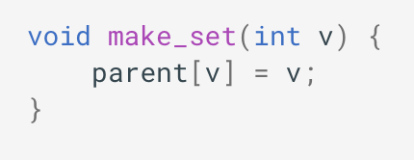
Disjoint-set forest
Operations: Make-Set
MAKE-SET(x): simply create a tree with root in the vertex v, meaning that it is its own ancestor.

Slide 16
Disjoint-set forest
Operations: Make-Set
MAKE-SET(x): creates a new tree with just one node. Point the parent to itself.
Initial member: 0, 1, 2, 3, 4
S₀ = {0}, S₁ = {1}, S₂ = {2}, S₃ = {3}, S₄ = {4}
parent[]
0 | 1 | 2 | 3 | 4
0
1
2
3
4

Slide 17
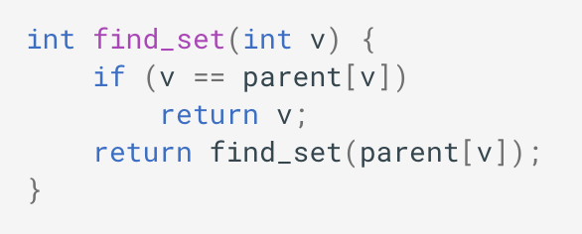
Disjoint-set forest
Operations: find-set
FIND-SET(x): simply climb the ancestors of the vertex v until we reach the root, i.e. a vertex such that the reference to the ancestor leads to itself.

Slide 18
Disjoint-set forest
Operations: find-set
FIND-SET(x): simply climb the ancestors of the vertex v until we reach the root, i.e. a vertex such that the reference to the ancestor leads to itself.
S₀ = {0}, S₂ = {1, 2}, S₄ = {3, 4},
FIND-SET(3) = 4
FIND-SET(1) = 2
parent[]
0 | 2 | 2 | 4 | 4
0
1
2
3
4

Slide 19
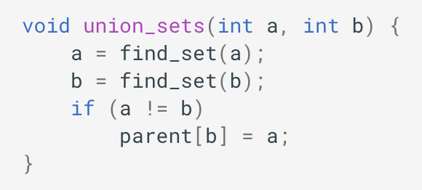
Disjoint-set forest
Operations: UNION
UNION(x, y): first find the representative of the set in which a (x) is located, and the representative of the set in which b (y) is located. If the representatives are identical, that we have nothing to do, the sets are already merged. Otherwise, specify that one of the representatives is the parent of the other representative - thereby combining the two trees.
Notes: we can also do parent[a] = b

Slide 20
Disjoint-set forest
Operations: union
UNION(x, y): unites the dynamic sets that contains x and y into a new set.
S₀ = {0}, S₁ = {1}, S₂ = {2}, S₃ = {3}, S₄ = {4},
UNION(4, 3) = S₄ ∪ S₃ = {3, 4}
parent[]
0 | 1 | 2 | 4 | 4
0
1
2
3
4

Slide 21
Disjoint-set forest
Operations: union
UNION(x, y): unites the dynamic sets that contains x and y into a new set.
S₀ = {0}, S₁ = {1}, S₂ = {2}, S₄ = {3, 4},
UNION(2, 1) = S₂ ∪ S₁ = {1, 2}
parent[]
0 | 2 | 2 | 4 | 4
0
1
2
3
4

Slide 22
Disjoint-set forest
Operations: union
UNION(x, y): unites the dynamic sets that contains x and y into a new set.
S₀ = {0}, S₂ = {1, 2}, S₄ = {3, 4},
UNION(3, 1) = S₄ ∪ S₂ = {1, 2, 3, 4}
parent[]
0 | 2 | 4 | 4 | 4
0
1
2
3
4

Slide 23
Disjoint-set forest
Operations: union
UNION(x, y): unites the dynamic sets that contains x and y into a new set.
S₀ = {0}, S₄ = {1, 2, 3, 4},
UNION(1, 0) = S₄ ∪ S₀ = {0, 1, 2, 3, 4}
parent[]
4 | 2 | 4 | 4 | 4
0
1
2
3
4

Slide 24
UNION by rank
Concept
If implemented naively without any optimization, then union operation can be slow.
The idea is to use a rank attribute to combine the two disjoint sets by making the root of a smaller tree to point at the root node of the larger tree.
Rank is a value that approximates the logarithm of the sub-tree size and is also an upper bound on the height of the node.

Slide 25
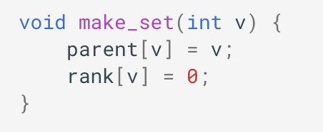
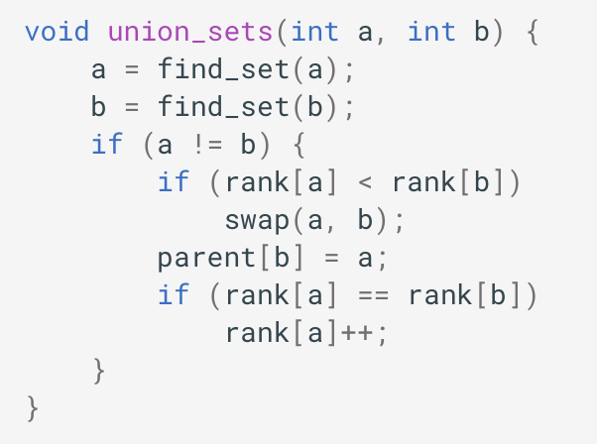
UNION by rank
Implementation
Here is the implementation of union by rank based on the depth of the trees:

Slide 26
Union by rank
example
S₀ = {0}, S₁ = {1}, S₂ = {2}, S₃ = {3}, S₄ = {4},
UNION(4, 3) = S₄ ∪ S₃ = {3, 4}
rank[4] = rank[3], rank[4]++
rank[]
0 | 0 | 0 | 0 | 1
0
1
2
3
4
parent[]
0 | 1 | 2 | 4 | 4
0
1
2
3
4

Slide 27
Union by rank
example
S₀ = {0}, S₁ = {1}, S₂ = {2}, S₄ = {3, 4},
UNION(2, 1) = S₂ ∪ S₁ = {1, 2}
rank[2] = rank[1], rank[2]++
rank[]
0 | 0 | 1 | 0 | 1
0
1
2
3
4
parent[]
0 | 2 | 2 | 4 | 4
0
1
2
3
4

Slide 28
Union by rank
example
S₀ = {0}, S₂ = {1, 2}, S₄ = {3, 4},
UNION(3, 1) = S₄ ∪ S₂ = {1, 2, 3, 4}
rank[4] = rank[2], rank[4]++
rank[]
0 | 0 | 1 | 0 | 2
0
1
2
3
4
parent[]
0 | 2 | 4 | 4 | 4
0
1
2
3
4

Slide 29
Union by rank
Example
S₀ = {0}, S₄ = {1, 2, 3, 4},
UNION(0, 1) >> rank[0] < rank[4], swap (0, 1)
UNION(1, 0) = S₄ ∪ S₀ = {0, 1, 2, 3, 4}
rank[]
0 | 0 | 1 | 0 | 2
0
1
2
3
4
parent[]
4 | 2 | 4 | 4 | 4
0
1
2
3
4

Slide 30
Path compression
Concept
Path Compression is the technique used for optimize the efficiency of the FIND-SET operation (as to increase the performance of find operation, every node is required to have a direct pointer to the root).
The algorithm works by checking if the node is already root, then no works need to be done. Otherwise, the pointer has to be updated to point to the root.

Slide 31
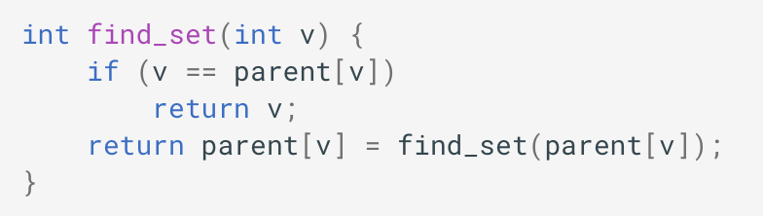
Path compression
implementation
The new implementation of find_set is as follows:

Slide 32
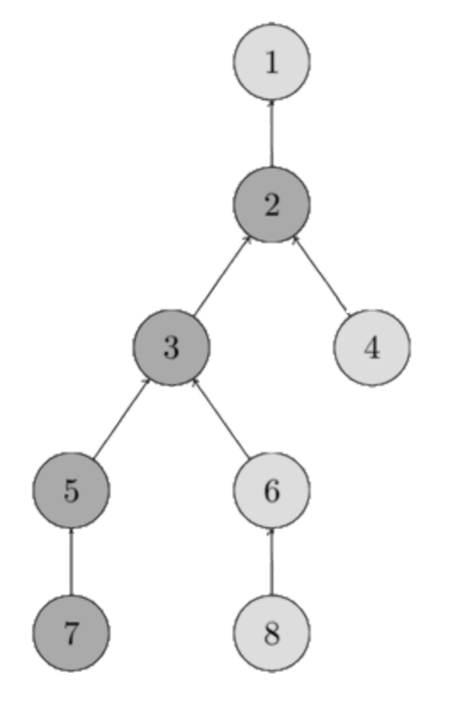
Path compression
example
Let’s say we currently have this disjoint set:
We called find-set(7) using path compression.
parent[]
1 | 1 | 2 | 2 | 3 | 3 | 5 | 6
1
2
3
4
5
6
7
8

Slide 33
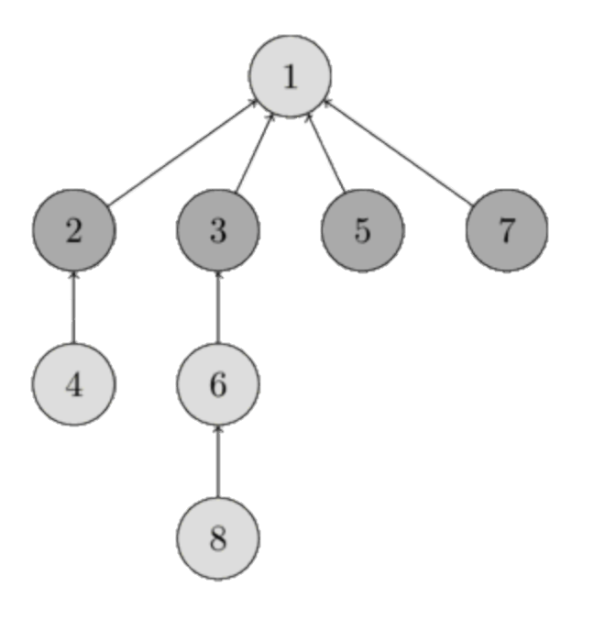
Path compression
example
The disjoint set will become like this:
Where the path from 7 until root (1) will be connected to the root itself.
parent[]
1 | 1 | 1 | 2 | 1 | 3 | 1 | 6
1
2
3
4
5
6
7
8

Slide 34
Path compression
example
What will happen to this disjoint set if you call find_set(1) with path compression?

Slide 35
References
S. Sridhar. 2015. Design and Analysis of Algorithms. Oxford University Press. New Delhi. ISBN: 9780198093695. Chapter 6
Thomas H. Cormen, Charles E. Leiserson, Ronald L. Rivest, & Clifford Stein. (2022). Introduction to Algorithms. 04. The MIT Press. London. ISBN: 9780262046305. Chapter 19.
Union-Find Disjoint Sets, https://visualgo.net/en/ufds?slide=1
Disjoint Set Union, https://cp-algorithms.com/data_structures/disjoint_set_union.html

